Slide 1

Institute for Stochastics and Applications Mathematical modeling and simulation of cellular systems
Leveraging Genetic Algorithms to Predict Initial Conditions for Optimal Spatial Patterns in 2D Reaction-Diffusion Systems
Loghman Samani
09.07.2024
Notes:
Welcome everyone to my presentation.
Today, I will talk about our project titled “Leveraging Genetic Algorithms to Predict Initial Conditions for Optimal Spatial Patterns in 2D Reaction-Diffusion Systems.”
This project is a collaborative effort by our team to explore and optimize patterns in complex systems using genetic algorithms.

Slide 2
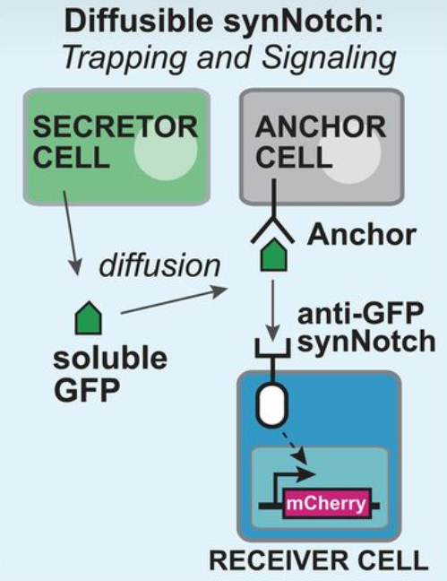
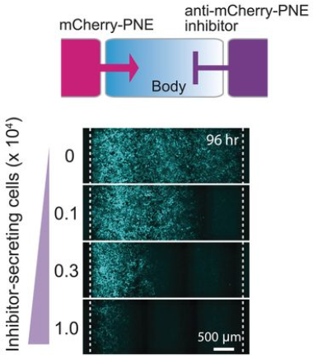
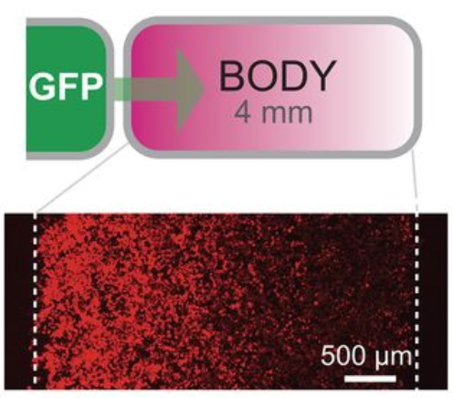
Synthetic morphogen systems
Synthetic Notch system
S. Toda et al., 2020
Arbitrary proteins engineered into synthetic morphogens.
Formation of gradients and directing cell patterning.
Applications in advanced tissue engineering.
“Engineering synthetic morphogen systems that can program multicellular patterning”
Diffusible synNotch system. (S. Toda et al., 2020)
Notes:
Initially, we were inspired by an article written by Toda and his colleages in 2020. They used the SynNotch system to see if molecules like GFP or mCherry could be turned into synthetic morphogens.
Looking at the figure on the top right, we see a diffusible SynNotch system. Here, secretor cells release GFP molecules, which are then sensed and received by other cells, changing their fate.
On the bottom right, we see how the gradient in tissue can be modified by trapping morphogens (GFP or mCherry) with anchor molecules on the surface of specific cells, as well as by morphogen inhibitors (mCherry/GFP-inhibitors) released from other specific cells in the tissue.

Slide 3
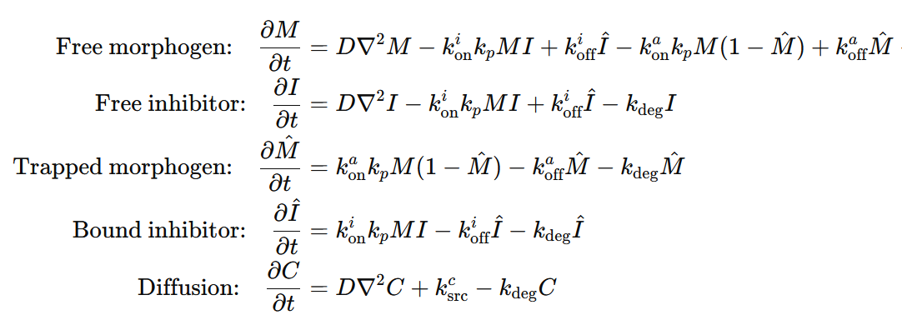
Computational model
Proteins Present in the System
Morphogen
Inhibitor
Anchor
Mathematical Equations (S. Toda et al., 2020)
Diffusion: Represents the spread of proteins
Inhibitor binding: Interaction between morphogen and inhibitor
Anchor binding: Interaction between morphogen and anchor
Degradation: Rate at which proteins degrade over time
Notes:
Here we see the mathematical equations from Toda's paper.
This simple system includes a morphogen, its inhibitor, and an anchor that can trap the morphogen.
The ODEs which describe the system conditions are free and trapped morphogen, and free and bound inhibitor.
Key terms (parameters) like k_on​, k_off​, k_secretion and k_degradation help us understand how these proteins interact and spread in the system.
The last equation shows how diffusion applies to both morphogen and its inhibitor.

Slide 4
Protein Secretion Patterns
Morphogen Secretion
Inhibitor Secretion
Cells capable of producing morphogen
Indicated by green cells
Cells capable of producing inhibitor
Indicated by red cells
Notes:
In our work, we started by defining a 2D compartment, similar to a tissue with a single cell layer.
We then designated specific cells as morphogen producers and others as inhibitor producers.
On the right, we see a schematic representation of this setup.
The top illustration shows morphogen-producing cells in green, located in the first column of the compartment.
The bottom one shows inhibitor-producing cells in red, located in the last column.

Slide 5
Diffusion Patterns
Analysis of protein diffusion in a 2D tissue compartment.
Examining three distinct diffusion patterns based on cell location.
Corner Cells
Edge Cells
Central Cells
Cells located at the four corners of the compartment.
Cells situated along the edges of the compartment.
Cells positioned in the middle, away from edges and corners.
Notes:
Next, we developed 2D-diffusion patterns. On the right, you can see three main diffusion patterns in the system.
The first one defines a diffution pattern for Corner Cells: These cells are in the four corners of the compartment and communicate with two neighboring cells.
The second one defines a pattern for Edge Cells: These cells are along the edges of the compartment and communicate with three neighboring cells.
And the last one is about Central Cells: These cells are in the middle, away from edges and corners, and communicate with four neighboring cells.
These diffusion patterns ensure that the diffusible proteins, such as morphogen and inhibitor, spread evenly throughout the system.

Slide 6
Simulation Results
Using ODEs to Simulate the System
Compartment Size: 100 x 100
GFP Production: First 10 columns on the left
GFP Inhibitor Production: First 10 columns on the right
Anchor Production: None
Free GFP Inhibitor-GFP Free Inhibitor
Notes:
Here, we are going to look at some simulation results using the system which i explained in the previous slides.
In this simulation, we have a morphogen (GFP), its inhibitor, and anchor cells that can trap the morphogen. However, in this specific case, there are no anchor-producing cells, so no morphogen will be trapped.
We defined the compartment as a 2D matrix with a size of 100 by 100 cells.
Cells in the first 10 columns on the matrix produce morphogen (GFP), while cells in the last 10 columns of the matrix produce the inhibitor(anti-gfp).
In the next slide, we will watch videos, each with three sub-videos, same as the illustration in this slide.
The left sub-video shows the compartment with free morphogen (GFP).
The right sub-video shows the free inhibitor
And the middle one shows the inhibited morphogen (or bound to the inhibitor).
We expect to see the morphogen and inhibitor spread out from their respective regions and after a while meet in the middle of the compartment, which will be shown in the middle sub-video.

Slide 7
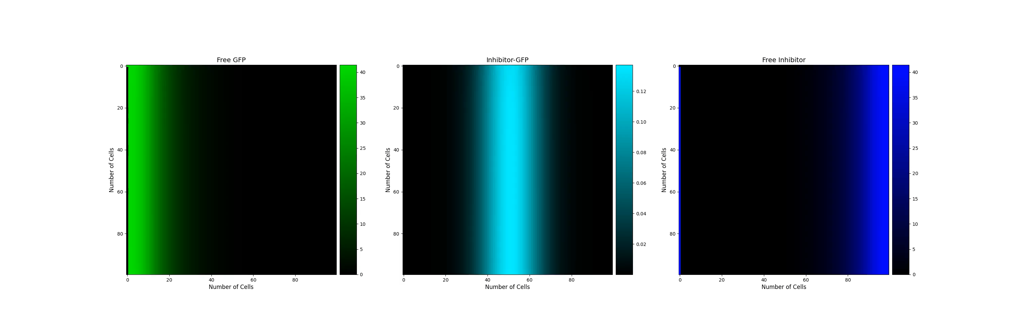
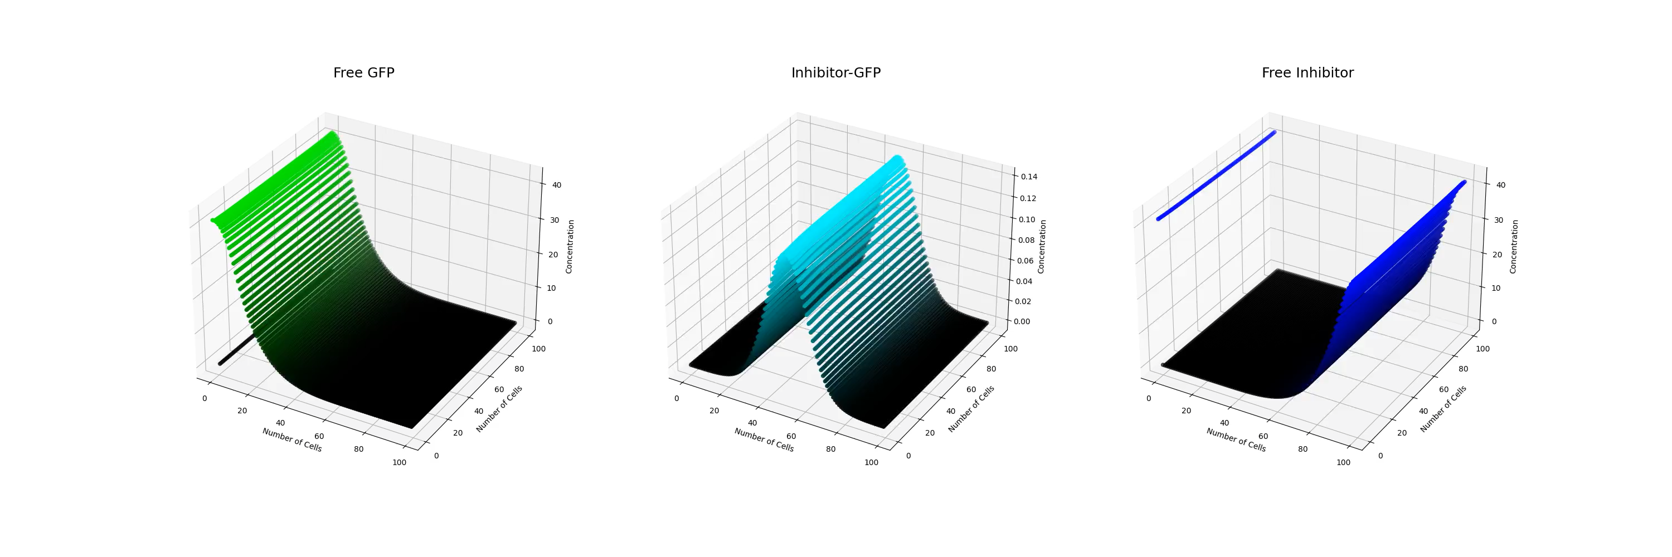
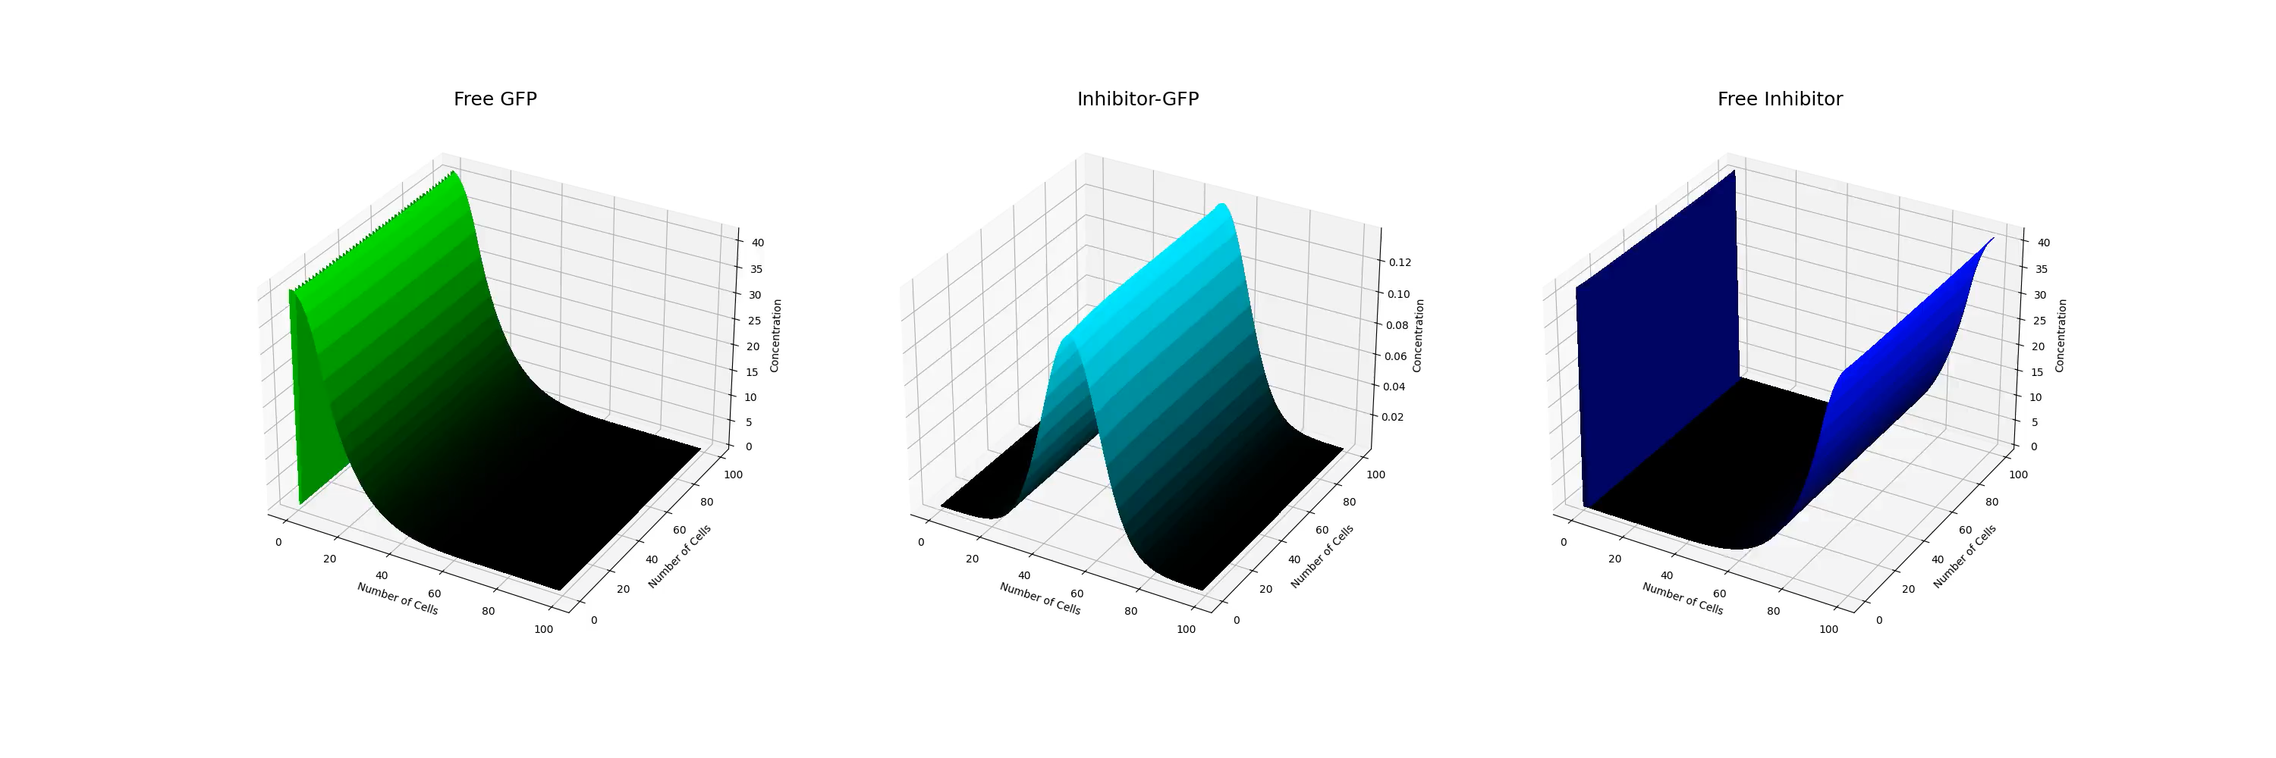
Number of iterations = 2500
Number of frames = 500
Initial morphogen and inhibitor concentration in each cell = 5
Notes:
Here in this slide, we see the videos, all generated from the same simulation results.
The first video shows heatmaps of the system, where pixel intensity represents cell protein concentration.
The second video is scatter plots, with the z-axis showing protein concentration.
And in the last row of videos illustrates the system as surface plots, with the z-axis again representing protein concentration.

Slide 8
Genetic Algorithms for Pattern Formation
R. Mousavi and D. Lobo, 2024
Using genetic algorithms to optimize initial protein concentrations for desired spatial patterns.
Develop a genetic algorithm to design and optimize protein concentrations for spatial pattern formation in our system.
“Automatic design of gene regulatory mechanisms for spatial pattern formation”
Notes:
After developing the simulation system described in the previous slides, we decided to advance our work by incorporating an optimization algorithm.
We were inspired by Mousavi and Lobo's work, published this year in Nature.
They developed an evolutionary algorithm that automatically designs synthetic gene regulatory mechanisms (GRMs) for complex spatial patterns.
We start our work with designing a simple version of Genetic Algorithms to predict the initial concentrations of components in our system based on the desired target protein distribution after simulation.

Slide 9
Genetic Algorithms (GAs)
Introduction
Population Initialization
mimic the natural selection process to find optimal solutions
Pioneered by John Holland’s work(1970s)
represent potential solutions as chromosomes
evolve populations towards better solutions by applying genetic operators like recombination and mutation
Simulation
Fitness Computation
Selection of Survivors
"Adaptation in Natural and Artificial Systems"
A. Lambora et al., 2019
Recombination (Crossover)
Mutation
Update Population
Return the Best Result/s
Notes:
The simple algorithm we developed is a Genetic Algorithm, as I mentioned before, inspired by biological evolution and natural selection.
John Holland pioneered this field in the 1970s, with his notable book "Adaptation in Natural and Artificial Systems" discussing genetic algorithms.
These sort of optimization algorithms use concepts like crossover, mutation, and selection to optimize solutions of a problem, which are represented as chromosomes.
On the right side, we see the structure of our designated algorithm. In the next slides, I will explain each concept in this system step by step.

Slide 10
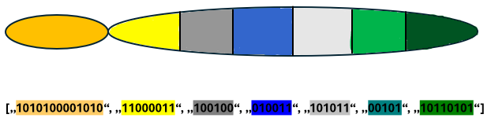
Genetic Algorithms
Population Initialization
Each species matrix is created as a random binary string.
Each chromosome is a list of binary strings.
Each string represents an initial species or parameter matrix.
The population is a nested list, with each value being a chromosome.
Parameters sp 1 sp 2 sp 3 sp 4 sp 5 sp 6
Notes:
The first step in our algorithm is population initialization. This involves creating a collection of potential solutions to the problem, known as the population.
Each solution, or chromosome in the population, is a list of randomly generated binary strings. These strings represent the initial concentrations of species and the parameters in the system.
So, the initialized population is a nested list, with each inner list being a chromosome consisting of sub-chromosomes or binary strings.
Each of these chromosomes represents a potential solution to the problem.

Slide 11
Genetic Algorithms
Simulation
Convert binary chromosomes into real number matrices.
Each converted chromosome is a list of species and parameter matrices.
Simulate the system using each chromosome.
Convert simulation results back to binary.
Store results in a list
Notes:
After initializing the population, the next step in the algorithm is to simulate the system with each chromosome in the population.
First of all, each chromosome is converted from binary strings into real number matrices, representing species and parameter matrices.
These matrices are then used to simulate the system.
The simulation results are stored in a list, and for further processing, these results are converted back into binary representation.

Slide 12
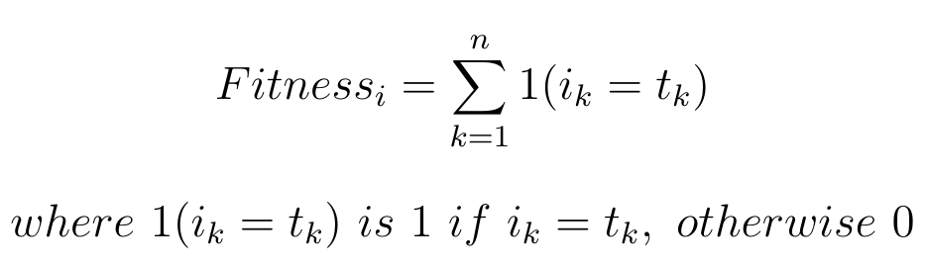
Genetic Algorithms
Fitness Computation
Evaluate how close each individual is to the target solution
Compare each simulation result binary string to the target binary string
Result is a list of fitness values for the population
Notes:
Next, the algorithm evaluates the simulation results.
Each simulation result is compared bit by bit to the target solution.
This way, the algorithm calculate a fitness score for each chromosome.
The goal of the algorithm is to maximize the fitness of each chromosome, bringing it closer to the target solution.

Slide 13
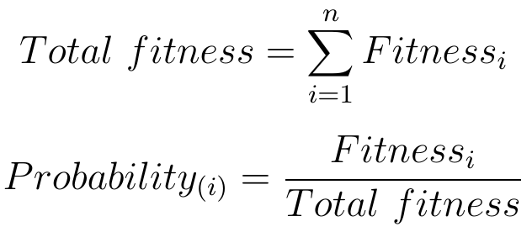
Genetic Algorithms
Selection of Survivors
Fitness Proportionate Selection (Roulette Wheel Selection)
Randomly select individuals based on their probabilities
Select parents for the next generation based on fitness scores
Result is a list of selected parents for the next generation
Notes:
In the next block, the algorithm selects the best chromosomes in the population based on their fitness.
Here we use the Roulette-Wheel Selection method, which gives chromosomes with higher fitness a better chance of being selected.
This step ensures that the best solutions are more likely to be represented in the next generation. it selects N chromosomes (n is equal to the population size) to form the pool for the next generation.

Slide 14
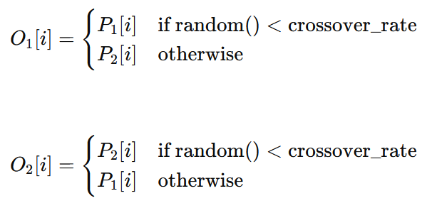
Genetic Algorithms
Recombination (Crossover)
Genetic recombination of parents to generate offspring
Offspring O1​ and O2​ inherit traits from both parents
crossover_rate: Probability of crossover.
i: Index of sub-chromosome in chromosomes
Notes:
In the next block of the algorithm, the selected pool of chromosomes, now referred to as parents, undergoes the crossover process.
In this step, the algorithm randomly pairs two parents from the population pool and exchanges information between their corresponding sub-chromosomes.
This exchanges are based on the crossover probabilities.
The result is a new population pool where each chromosome is now an offspring, inheriting traits from both parents.

Slide 15
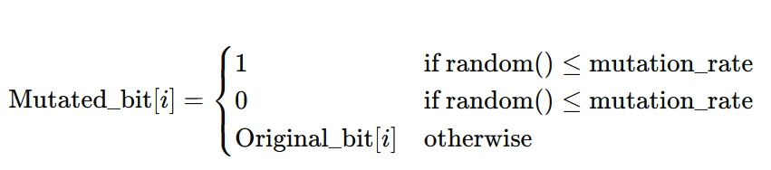
Genetic Algorithms
Mutation
Introduce random changes to the chromosome
Enhance genetic diversity for better exploration
prevent local minima
mutation_rates: Probability of mutating each bit
Notes:
In the next part of the algorithm, each offspring chromosome undergoes mutation.
In this process, each bit in the sub-chromosomes of each chromosome has a chance to be flipped, meaning a 0 becomes a 1 and a 1 becomes a 0.
This happens with a specific mutation rate defined for each sub-chromosome.
This step introduces random changes to enhance genetic diversity and prevent the algorithm from getting stuck in local minima.

Slide 16
Genetic Algorithms
Update the population
Stop: If desired or optimal fitness achieved
Update: Otherwise, update population and repeat
Iterative Process: Continues until convergence
Notes:
After mutation, each offspring is sent to the next generation, creating a new population pool.
This iterative process continues until one or more chromosomes in the population achieve the desired fitness level or a predefined fitness threshold is reached.
When this happens, the algorithm has converged, and the best solution, corresponding to the highest fitness, is returned as the output of the algorithm.

Slide 17
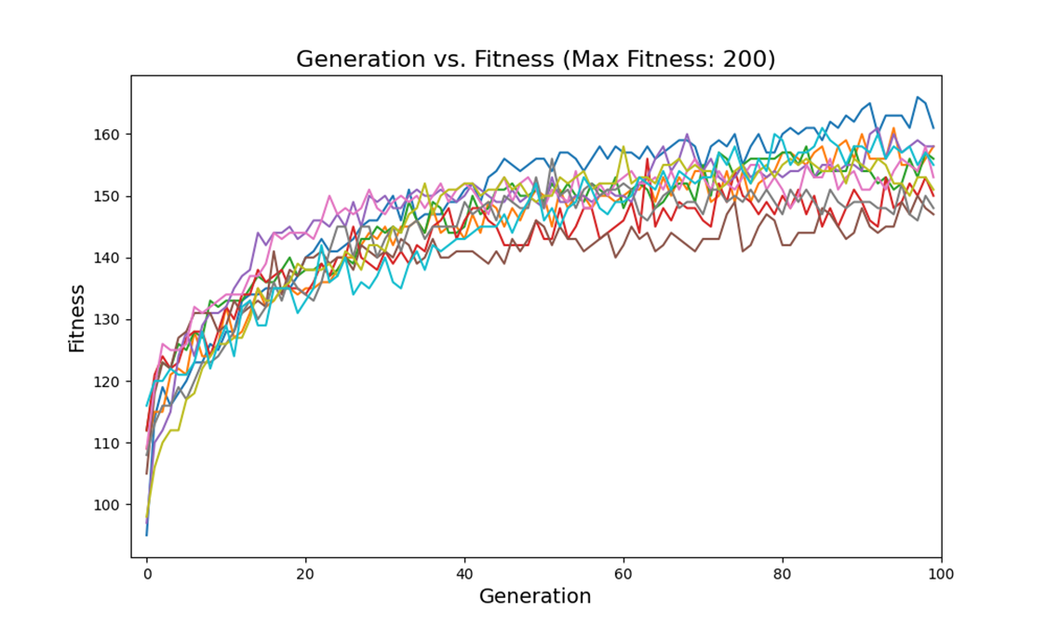
Testing Genetic Algorithm on a Two-Species System
A system with two species
Compartment size: (5, 5)
Cells in the first column produce species 1
Cells in the third column produce species 2
Species 1 activates species 2
Six parameters are defined for the system
Notes:
To test the genetic algorithm, we used a system with two species in a 5 by 5 cell compartment.
Cells in the first column of the compartment can produce and spread species 1, while cells in the third column can produce and release species 2.
Species 1 acts as an activator for species 2, meaning species 2 production only occurs when species 1 molecules are present in the third column.
We used the simulation results, specifically the concentration of species 2 after simulation, as the target for our genetic algorithm.
The algorithm was run multiple times to optimize the initial concentrations of each species and also parameters.
In the figure, we see the results from 10 runs of the algorithm, each with 100 iterations. Each time the algorithm converged to a certain point but still didn't find the initial conditions that lead to the maximum fitness.
The maximum fitness here was 200 and the best found fitness was 165.

Slide 18
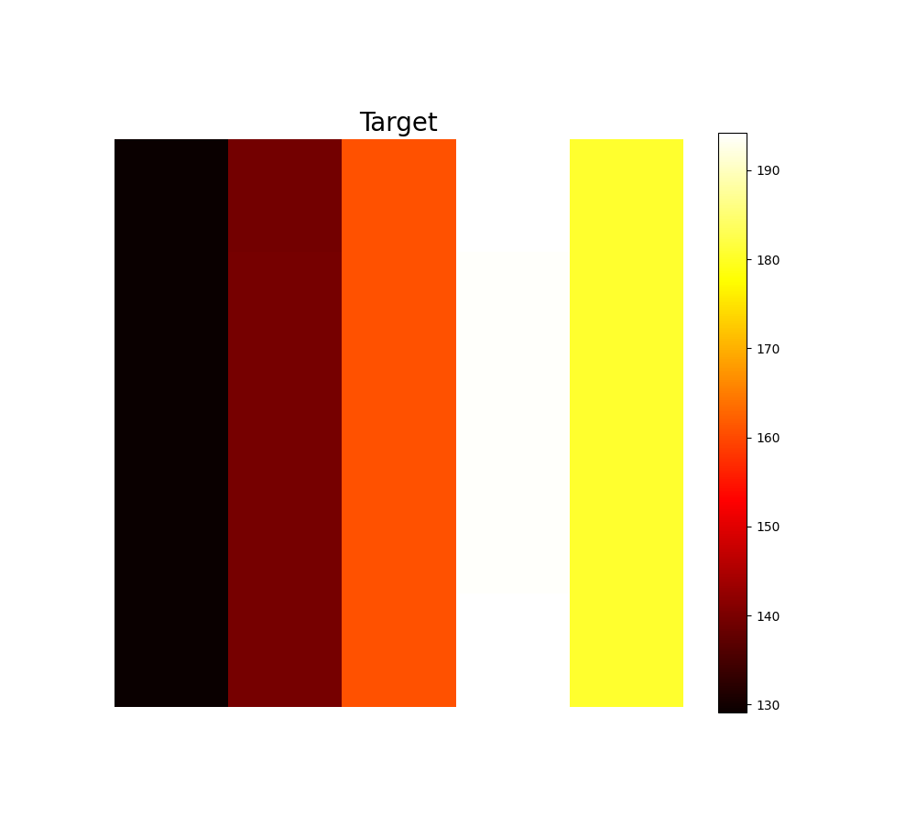
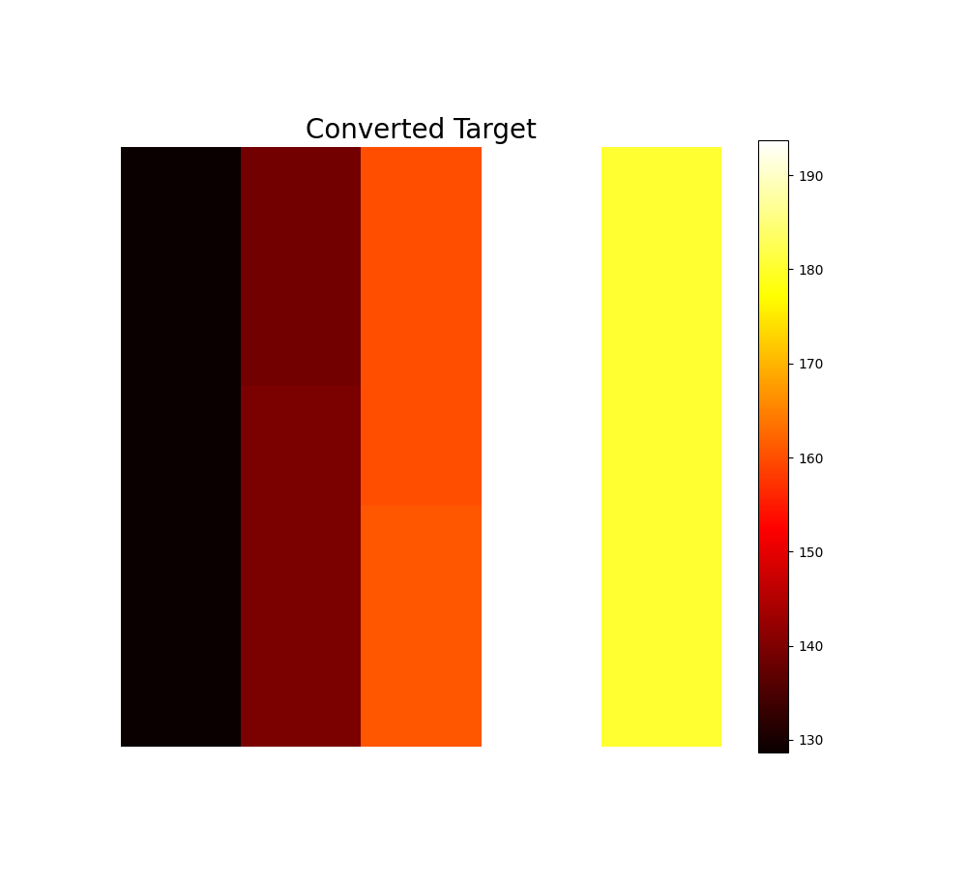
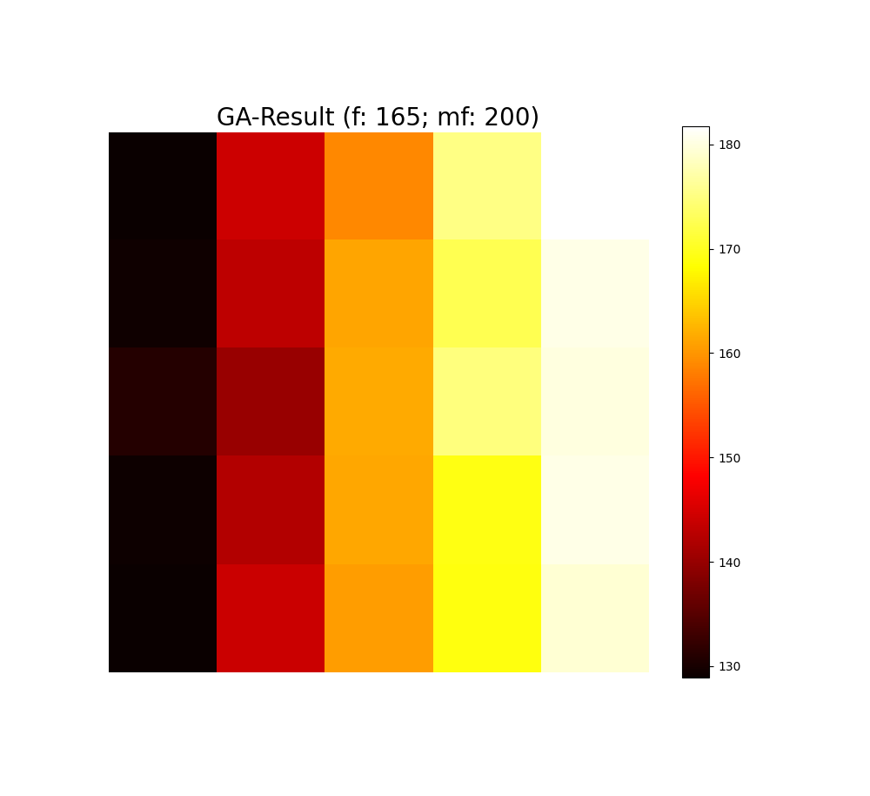
Testing Genetic Algorithm on a Two-Species System
Max Fitness: 200
Best Found Fitness: 165
Notes:
Here we see the heatmap results for one of the trials.
The first heatmap on the left shows the target, which represents the species 2 distribution in the compartment after simulating the system.
In the middle, we see the same target after converting it to binary and back to a real number. This conversion shows slight changes compared to the original target, indicating some information loss during these conversions.
And the heatmap on the right illustrates the result with the highest fitness the algorithm could achieve.

Slide 19
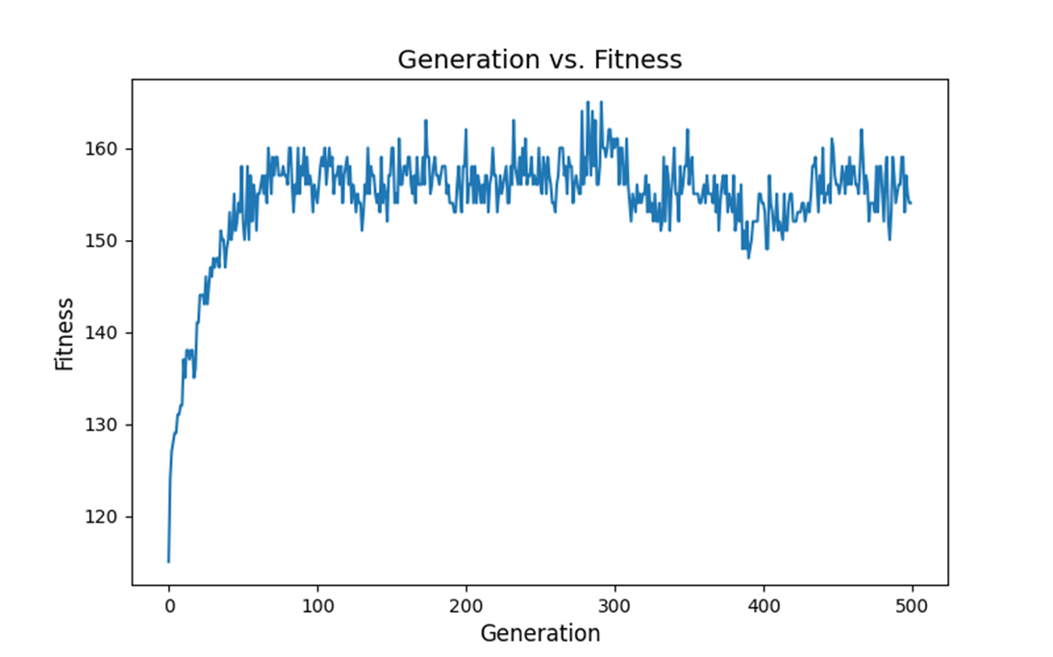
Testing Genetic Algorithm on a Two-Species System
Results after 500 Iterations
Notes:
In another trial, we ran the algorithm for 500 iterations to see if the results could improve beyond the initial 100 iterations.
However, as we can see here, the system's performance did not improve significantly after about 100 iterations, indicating that the algorithm could not optimize the system further despite the increased iterations.

Slide 20
Challenges and Solutions
Computational Intensity
Model Specificity
Non-Uniform Gradient in Diffusion
GA Inefficiency
Solution: Parallel computation, Numba (@jit)
Solution: Generalize with modular blocks
Solution: Optimize diffusion calculation method
Solutions:
Improve fitness function
Alternative chromosome representation
Better selection methods
Notes:
In our project we face several challenges.
The first one is, computational intensity in both simulation and GA optimization. To address this, we will try to parallelize computation by vectorizing the code and also use libraries like Numba, which we already used in our simulation models.
Second issue is about the specificity of models requires us to write specific code for each model. To overcome this, we will generalize the models using modular building blocks, which allow us to select components based on our needs.
Third challenge is, the species diffusion in our simulations does not maintain a uniform gradient, which is problematic as we expect uniformity given the same initial concentrations. this issue likely stemmed from calculating diffusion in a loop, leading to inconsistencies. We will optimize the diffusion calculation method and we will see if it resolves this issue.
Lastly, the efficiency of our genetic algorithm is not optimal. The current model does not converge completely due to several factors:
1) The current fitness function may not be the best as it maximizes fitness using bit-by-bit comparison.
2) The binary representation of chromosomes increases their length, making them less efficient and also more difficult to find the 100% match solution.
3) Tnd the selection methods we use currently in our model, which are Roulette-Wheel and tournament (which I did not mentioned here), may not be the most effective selection methods. We will explore new approaches and functionalities to improve this part of the model.

Slide 21
Outlook
Improve Current Models
Add Growth Rate
Enhance Information Sharing
Increase Diffusion Edges
Advance GA Algorithm
Combine Optimization Algorithms
Simulate in Higher Dimensions
Incorporate Stochastic Methods
Create a Simulation Library
Notes:
In the future, we aim to improve our current models by solving the challenges mentioned in the previous slide.
Another goal is to add a growth rate to our system, allowing the number of cells to increase over time, mimicking biological growth.
We plan to enhance information sharing by allowing cells to communicate with more neighbors, not just the first cell at each edge.
Additionally, we’ll increase the diffusion edges, allowing cells to share information in more directions.
We also plan to advance our GA algorithm, enabling it to add new species through insertion mutation, and also delete species from the system using deletion mutation, introducing non-linearity into predictions.
we’ll explore combining different optimization algorithms to improve the performance of our models.
We may also explore simulating our system in higher dimensions, moving from 2D to 3D.
We may incorporate stochastic methods to simulate the system, adding variability to our models.
Finally, We may collect the functionalities in our work in a simulation library.

Slide 22
Thank you for your time and attention
Notes:
That concludes my presentation. Thank you all for your time and attention. If you have any questions about our work, please feel free to ask.

Slide 23
hm1.mp4
infos = { "compartment length": 100, "compartment width": 100, "initial cell number": 5, "start": 1, "stop": 50, "dt": 0.02, "save step interval": 5, "k_fm_sec": 0.5, "k_fi_sec": 0.5, "k_am_on": 0.04, "k_am_off": 2e-6, "k_im_on": 0.2, "k_im_off": 2e-4, "k_fm_deg": 0.02, "k_fi_deg": 0.02, "k_im_deg": 0.02, "k_am_deg": 0.02, "k_m_diff": 4, "k_i_diff": 4, "k_im_diff": 3 }
Number of iterations = 2500
Number of frames = 500
Initial cell number: initial concentration of morphogen or inhibitor in capable cells. (initial cell number/ ratio: initial concntration of anchor in capable cells(5))

Slide 24
Simulation GA
sp1 = np.zeros((5, 5)) sp2 = np.zeros((5, 5)) sp1_cells = np.zeros((5, 5)) sp1_cells[:, 0] = 5 sp2_cells = np.zeros((5, 5)) sp2_cells[:, 3] = 2 params = np.array([[3, 3, 2, 2, 0.1, 0.1]]) dt = 0.01 sim_start = 1 sim_stop = 20 epochs = 500 target_shape = (5, 5) result = simulation(sp1, sp2, sp1_cells, sp2_cells, params, dt, sim_start, sim_stop, epochs, target_shape)
file = h5py.File("/home/samani/Documents/sim/sim.h5", "r") sp2 = file["sp2"][:] precision_bits = {"sp1": (0, 5, 8), "sp2": (0, 200, 8), "sp1_cells": (0, 5, 8), "sp2_cells": (0, 5, 8), "params": (0, 4, 8)} genetic_algorithm( population_size=300, specie_matrix_shape=(5, 5), precision_bits=precision_bits, num_params=6, max_generation=200, mutation_rates=[.02, .02, .02, .02, .01], crossover_rates=[.85, .85, .85, .85, .85], num_crossover_points=[2, 2, 2, 2, 1], target=sp2, target_precision_bits=(0, 200, 8), result_path="/home/samani/Documents/sim", selection_method="tournament", tournament_size=20, file_name="new", dt=0.01, sim_start=1, sim_stop=20, epochs=500, fitness_trigger=False )

Slide 25
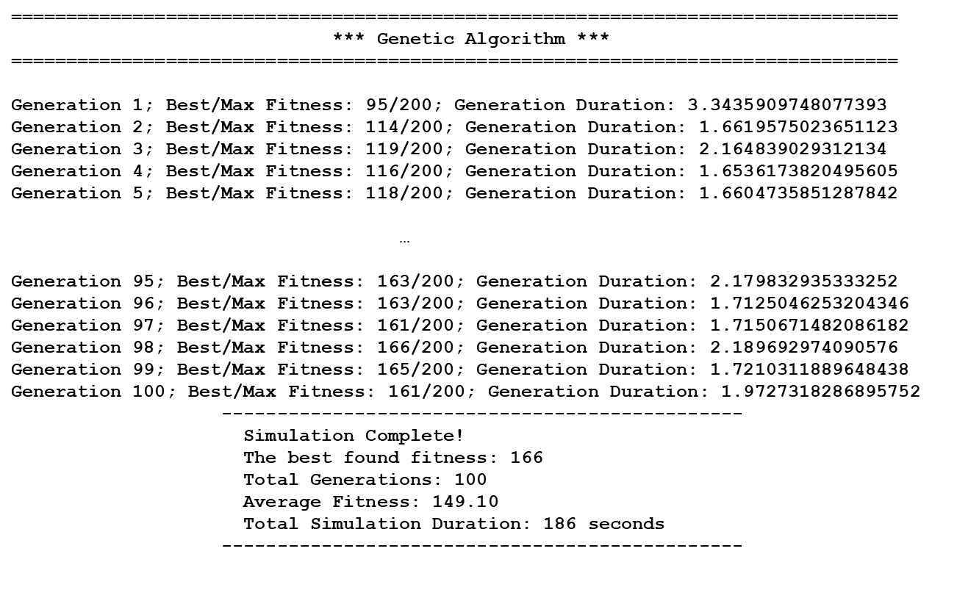

Slide 26
========================================================================= *** Genetic Algorithm *** ========================================================================= Generation 1; Best/Max Fitness: 7822/9000; Generation Duration: 9.718567848205566 Generation 2; Best/Max Fitness: 4820/9000; Generation Duration: 7.502077102661133 Generation 3; Best/Max Fitness: 4744/9000; Generation Duration: 7.482980489730835 ... Generation 98; Best/Max Fitness: 8728/9000; Generation Duration: 7.52039647102356 Generation 99; Best/Max Fitness: 8728/9000; Generation Duration: 7.5197718143463135 Generation 100; Best/Max Fitness: 8728/9000; Generation Duration: 7.525475025177002 ----------------------------------------------- Simulation Complete! The best found fitness: 8729 Total Generations: 100 Average Fitness: 8391.85 Total Simulation Duration: 778 seconds -----------------------------------------------

Slide 27
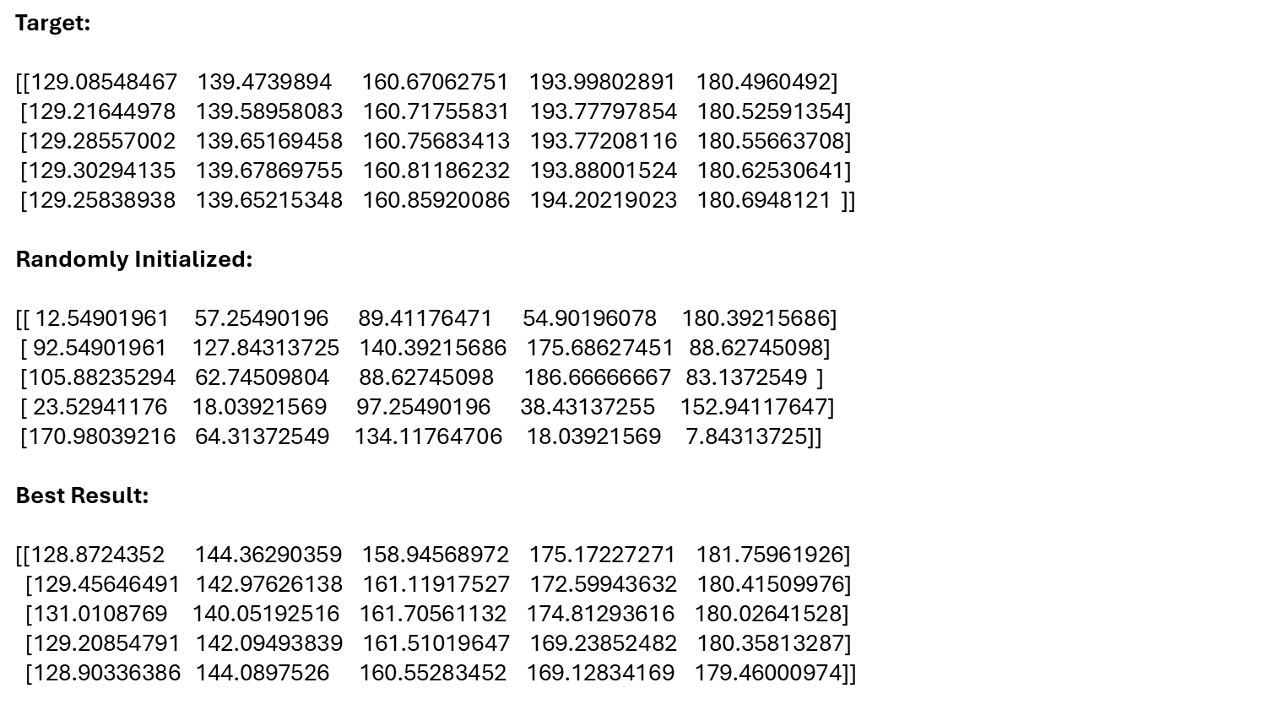
Max Fitness: 200
Best Fitness: 165
Parameters:
[3, 3, 2, 2, 0.1, 0.1]
Optimized parameters:
[3.56078431, 1.20784314, 0.94117647, 4.0, 0.37647059, 0.62745098]

Slide 28
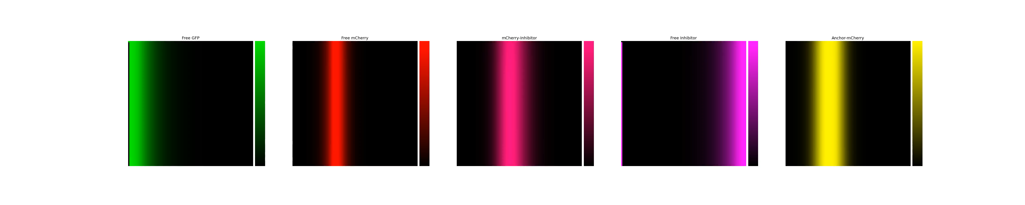

Slide 29
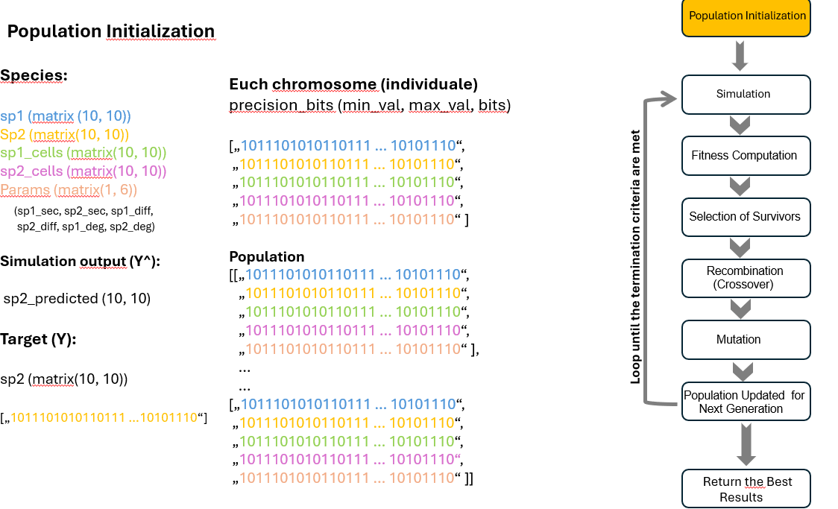

Slide 30
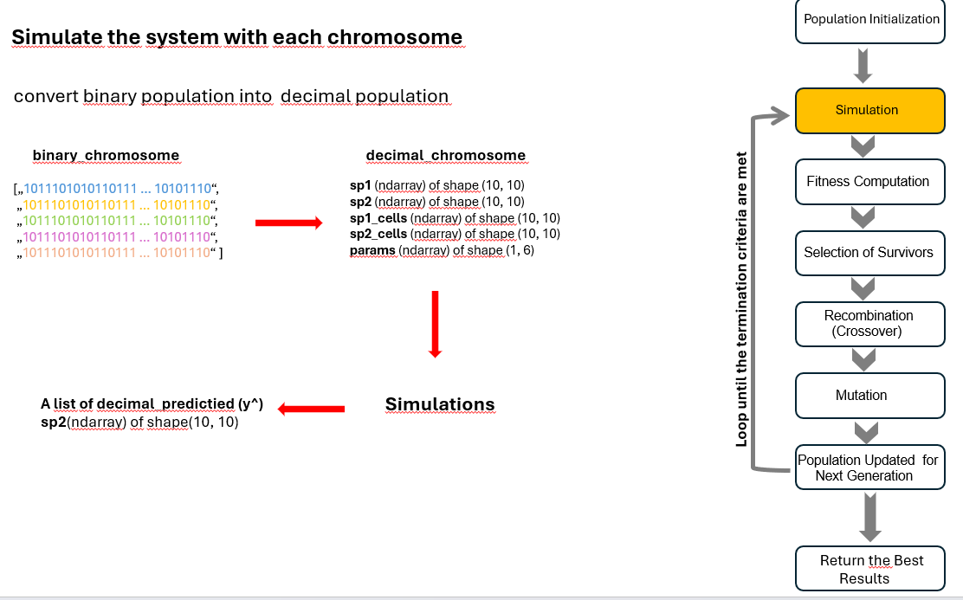

Slide 31
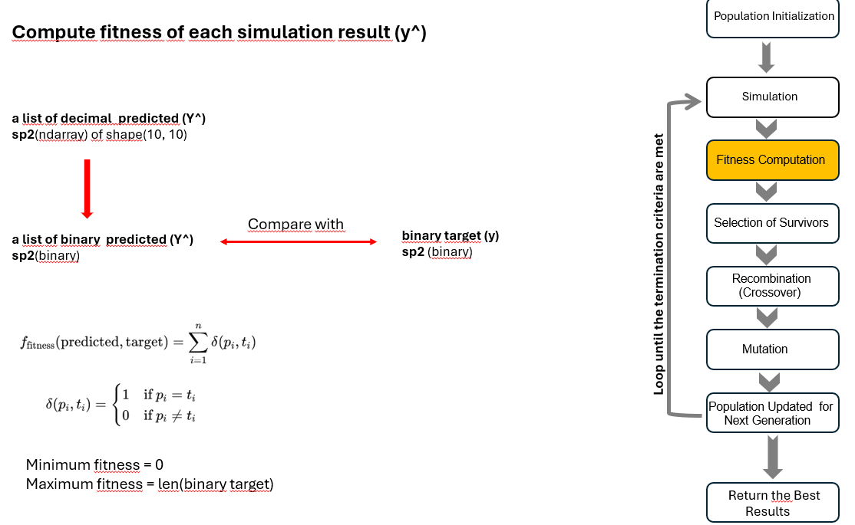

Slide 32
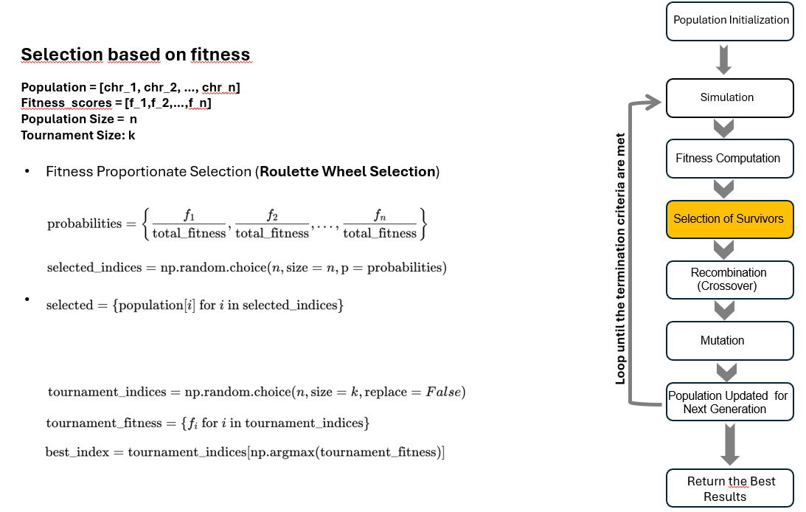

Slide 33
